Slide 1
Smart Display Accessibility Modes (S-DAM)
A Programmatic Approach to Improve Accessibility on Digital Displays for Light and Contrast Sensitivity
Kevin John Cherian Joseph
Arnob Mallick

Slide 2
Introduction
V | R | S | K | D
R | N | C | S | O
H | S | F | N | V
Z | V | K | N | H
D | N | S | R | K
What is Contrast and Light Sensitivity?
Who does it affect?
Why does it matter?

Slide 3
Introduction
V | R | S | K | D
R | N | C | S | O
H | S | F | N | V
Z | V | K | N | H
D | N | S | R | K
What is Contrast and Light Sensitivity?
Who does it affect?
Why does it matter?

Slide 4
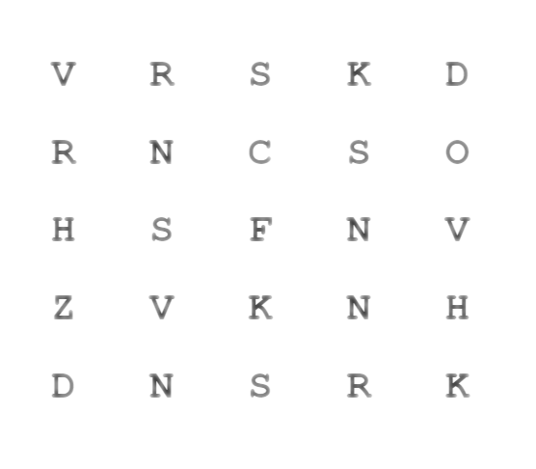
Introduction
What is Contrast and Light Sensitivity?
Who does it affect?
Why does it matter?

Slide 5
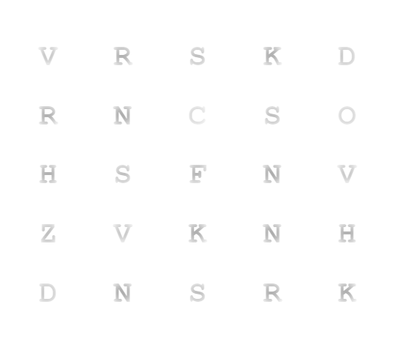
Introduction
What is Contrast and Light Sensitivity?
Who does it affect?
Why does it matter?

Slide 6
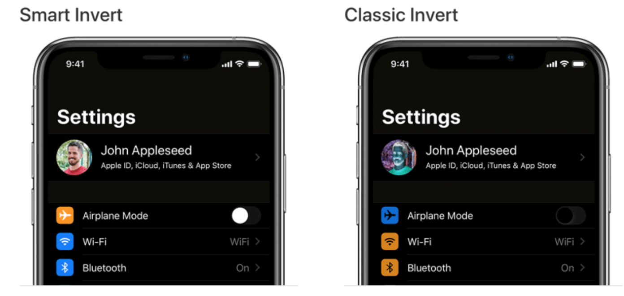
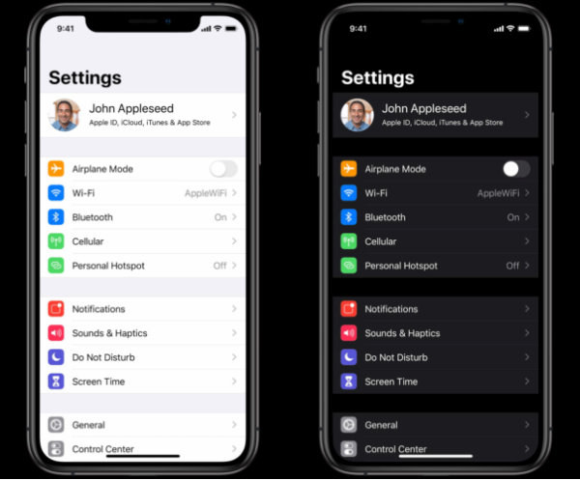
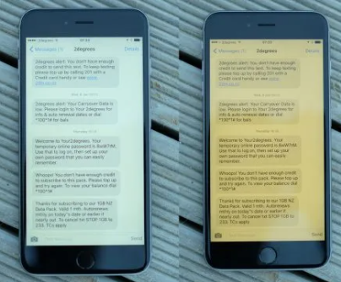
Existing Solutions
Classic Invert
Smart Invert
Dark Mode
Night Shift
Color Correction
etc.

Slide 7
Our Implementation
Smart Display Accessibility Modes (S-DAM)
Display mode for contrast or light sensitive users
Skip media like images and video
Does not require extensive developer input
Agnostic to platform

Slide 8
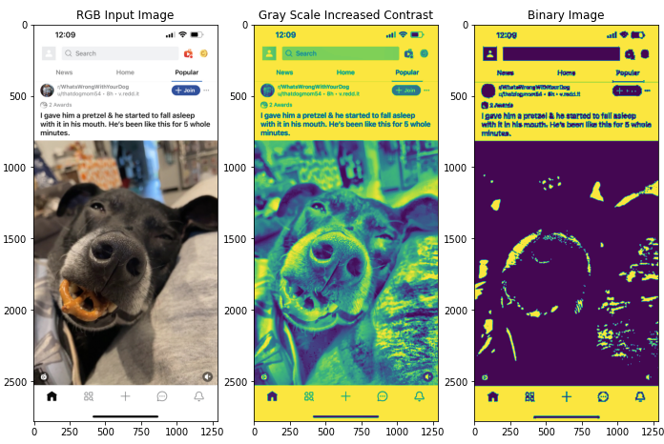
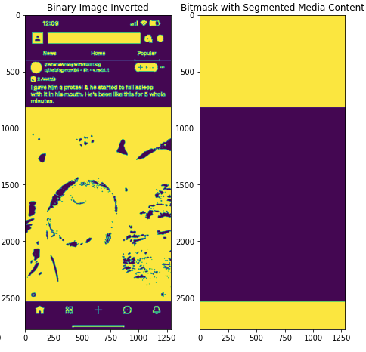
Our Implementation
Step 1 - Detect Media Content
Goal - segment media (images) from background, text, and UI
OpenCV - C++, Python, Java

Slide 9
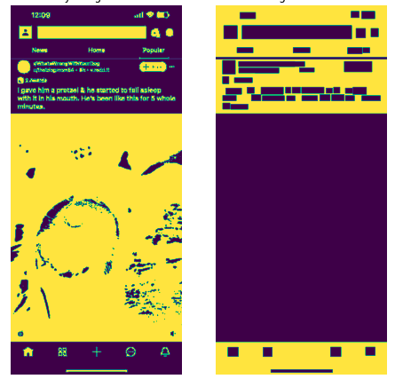


Our Implementation
Step 1 - Detect Media Content
Contour Shape - Rectangle
Contour Area
Area > 1000 Area > 10000 Area > 90000

Slide 10
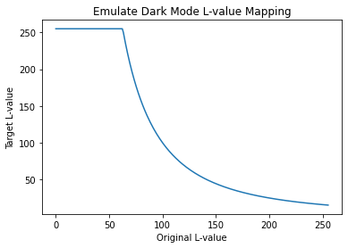
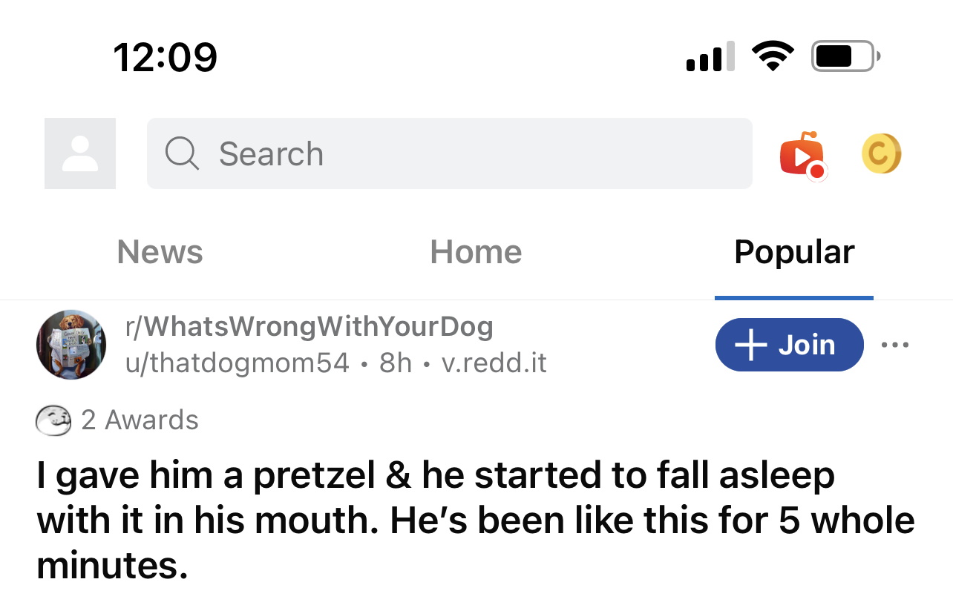
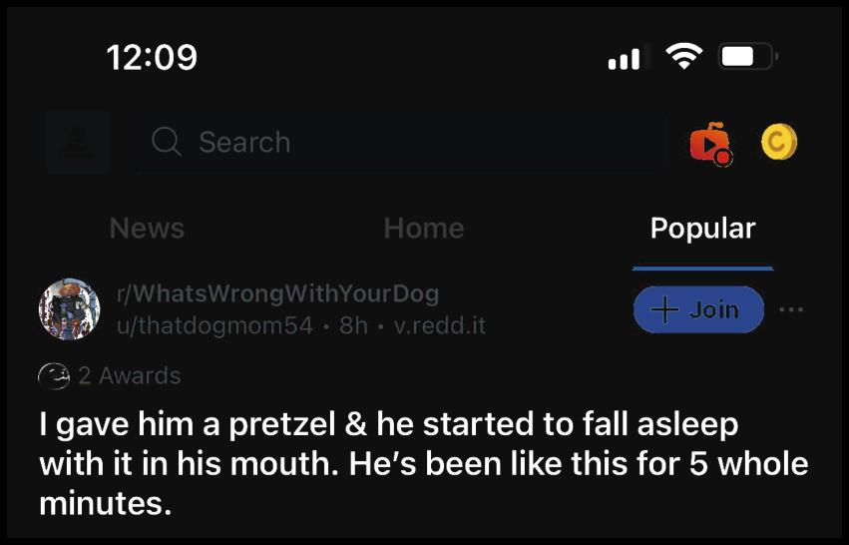
Our Implementation
Step 2 - Emulate Dark Mode
Goal - Take background/UI content and turn it dark

Slide 11
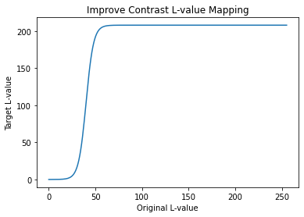
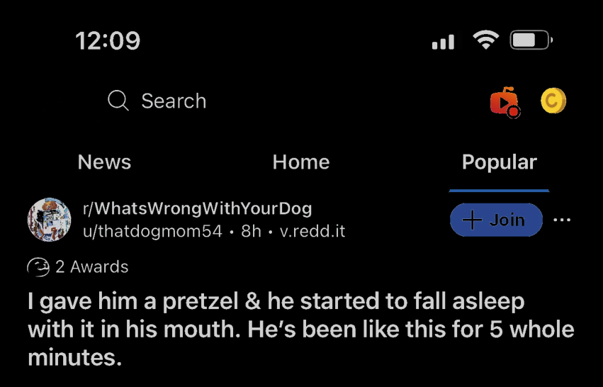
Our Implementation
Step 3 - Improve Contrast
Goal - Improve the contrast of the generated dark mode

Slide 12
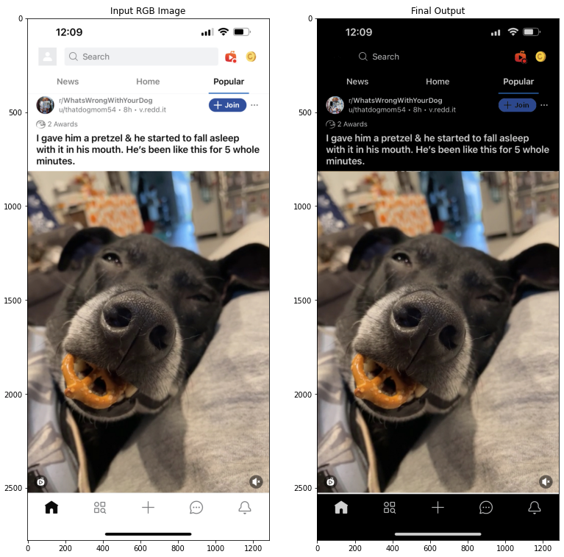
Our Implementation
Final Result
Good
Images preserved
Icon colors preserved
All text and symbols legible
Meh…
Join button text color
Subreddit icon slight distortion
Loss of search text box bounds

Slide 13
Evaluation
Effective Light Output
App Category | App Name | Original | Dark Mode | Smart Invert | S-DAM
Life Style | Yelp | 213.58 | N/A | 41.02 | 81.65
 | Uber Eats | 201.71 | N/A | 73.01 | 135.16
Social | Reddit | 164.70 | 75.53 | 90.79 | 74.81
 | Twitter | 201.56 | 56.93 | 60.14 | 91.19
Financial | Paypal | 219.66 | N/A | 35.33 | 114.30
WeView | Chrome Browser | 184.93 | 152.04 | 69.49 | 61.11
Measures total ‘light’ emitted by a screen
In HSL color scheme, average L-value
Lower score is better
S-DAM always better than Original
S-DAM worse than alternatives when it makes mistakes

Slide 14
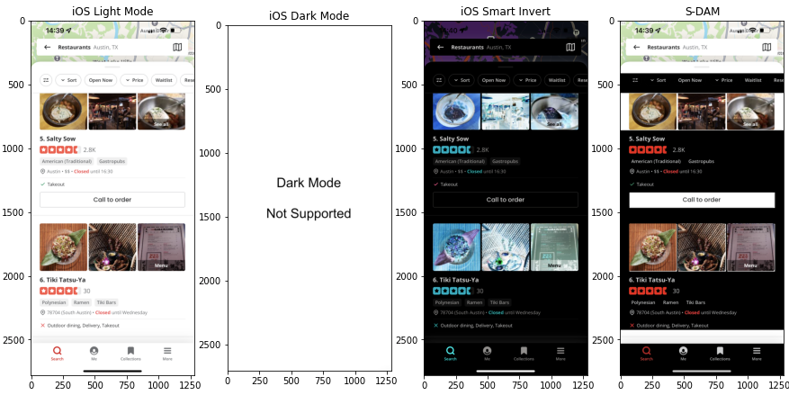
Evaluation
Accuracy - Yelp

Slide 15
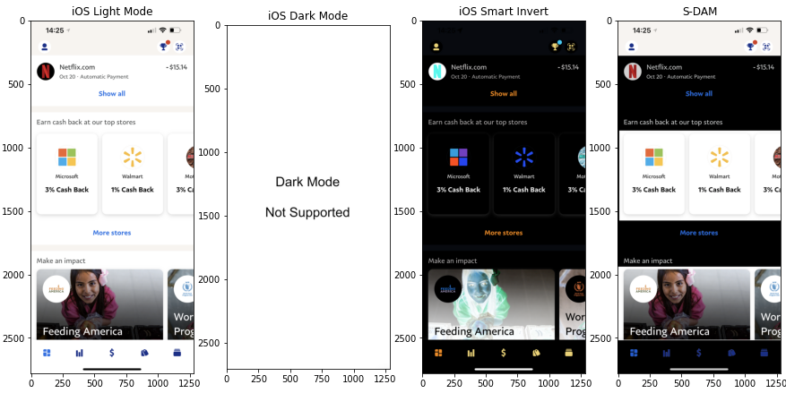
Evaluation
Accuracy - PayPal

Slide 16
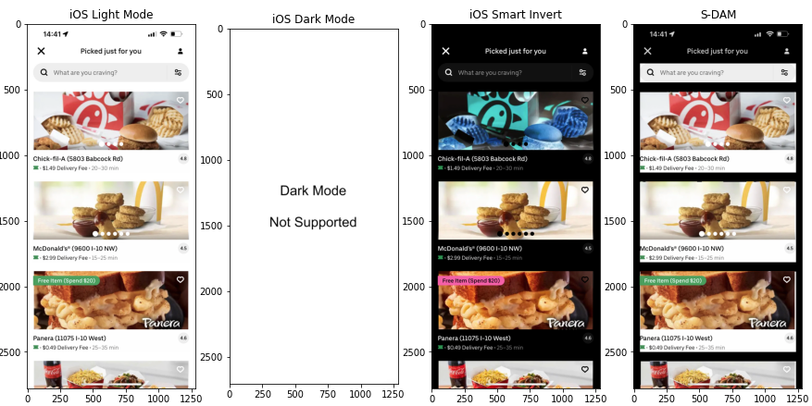
Evaluation
Accuracy - UberEats

Slide 17
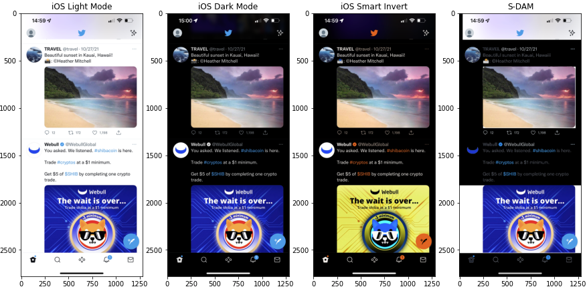
Evaluation
Accuracy - Twitter

Slide 18
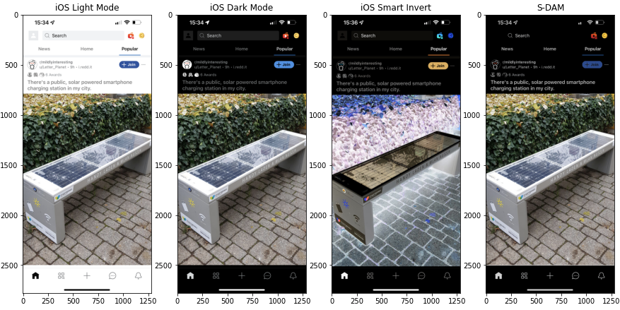
Evaluation
Accuracy - Reddit

Slide 19
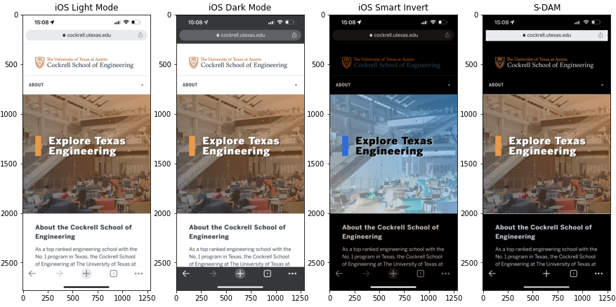
Evaluation
Accuracy - Chrome

Slide 20
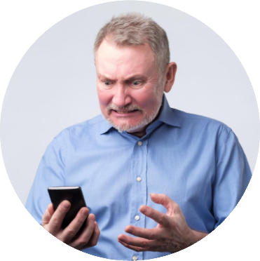

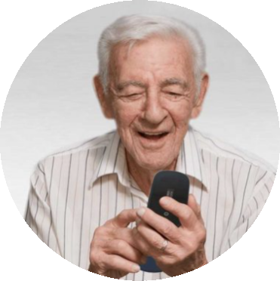

Future Work
Improve image segmentation step
ML?
Multiple stages?
Evaluate real-time performance
Implement as a Browser Extension
Implement for Desktop
Tune parameters and thresholds
Optimize for different application types

Slide 21
Questions?
https://github.com/friedliver/smart-accessibility-modes-for-mobile-display

